Slide 1
Automatic Home
CSE322 – G2 SLOT

Slide 2
Abstract
We are going to use an Arduino controller to control the home appliances without any wired connection.
The wireless connectivity of the Arduino based automation system uses the simple components like relay and resisters.
It controls the home appliances by using the Wi-Fi enabled device.
We use an Arduino UNO Board along with Arduino Ethernet Shield to give it a wireless connectivity.
Arduino runs a code to control a Relay board according to the input and also serves a web page through which respective output to the relay board can be controlled.
Through relay controller board we can control lamps, tubes or any AC power sockets.

Slide 3
Components Required
1K Resistor - 2
Red LED 3mm - 2
Arduino YUN
Connecting wires

Slide 4
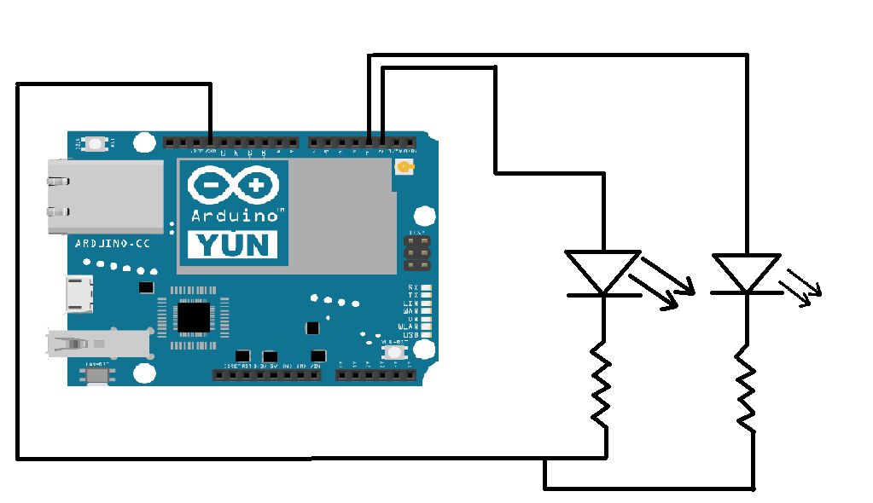
Schematic diagram

Slide 5
Arduino code
#include <Bridge.h>
#include <YunServer.h>
#include <YunClient.h>
int LEDPIN2 = 2;
int LEDPIN = 3;
YunServer server;
void setup() {
Serial.begin(9600);
pinMode(LEDPIN,OUTPUT);
digitalWrite(LEDPIN,HIGH);
digitalWrite(LEDPIN2,HIGH);
Bridge.begin();
digitalWrite(LEDPIN,LOW);
digitalWrite(LEDPIN2,LOW);
delay(500);

Slide 6
Arduino code
digitalWrite(LEDPIN,HIGH);
digitalWrite(LEDPIN2,HIGH);
delay(500);
digitalWrite(LEDPIN,LOW);
digitalWrite(LEDPIN2,LOW);
delay(500);
digitalWrite(LEDPIN,HIGH);
digitalWrite(LEDPIN2,HIGH);
delay(500);
digitalWrite(LEDPIN,LOW);
digitalWrite(LEDPIN2,LOW);
delay(500);
server.begin();
}

Slide 7
Arduino code
void loop() {
YunClient client = server.accept();
if (client) {
process(client);
client.stop();
}
delay(50);
}
void process(YunClient client) {
String command = client.readStringUntil('\\');
client.println("Status: 200");
client.println("Content-type: text/html");
client.println();
client.println("<B><Center>");

Slide 8
Arduino code
client.println("LED 1");
client.println("<button><a href='http://yun.local/arduino/1\\'>Turn ON LED</a></button>");
client.print("<button><a href='http://yun.local/arduino/2\\'>Turn OFF LED</a></button><br>");
client.println("</B></Center>");
client.println("<B><Center>");
client.println("LED 2");
client.println("<button><a href='http://yun.local/arduino/3\\'>Turn ON LED</a></button>");
client.print("<button><a href='http://yun.local/arduino/4\\'>Turn OFF LED</a></button><br>");
client.println("</B></Center>");

Slide 9
Arduino code
int str=command.toInt();
if (str == 1) {
digitalWrite(3,HIGH);
client.println("<B><Center>");
client.print("Command: ");
client.println("ON");
client.println("</B></Center>");
}
if (str == 2) {
digitalWrite(3,LOW);
client.println("<B><Center>");
client.print("Command: ");
client.println("OFF");
client.println("</B></Center>");
}

Slide 10
Arduino code
if (str == 3) {
digitalWrite(2,HIGH);
client.println("<B><Center>");
client.print("Command: ");
client.println("ON");
client.println("</B></Center>");
}
if (str == 4) {
digitalWrite(2,LOW);
client.println("<B><Center>");
client.print("Command: ");
client.println("OFF");
client.println("</B></Center>");
}
}

Slide 11
THANK YOU

